Slide 1
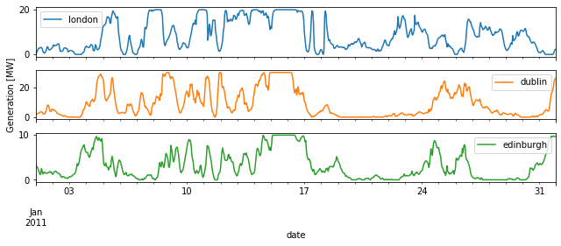
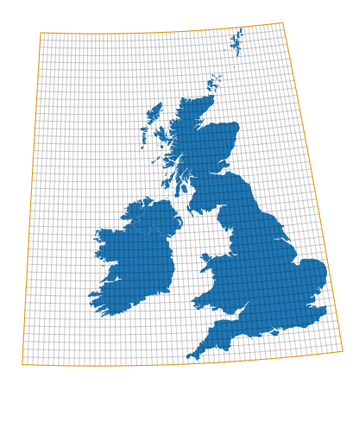
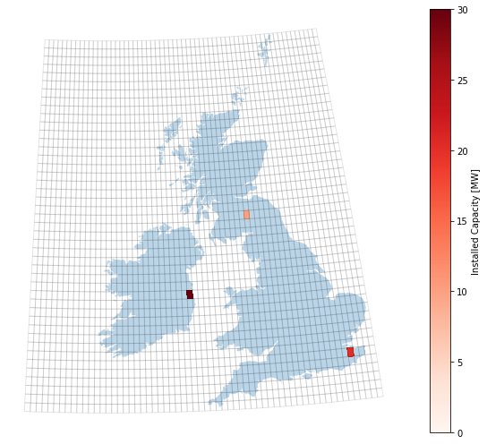
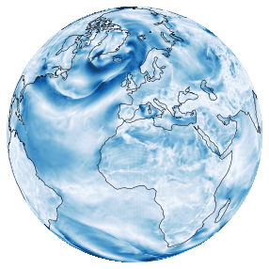
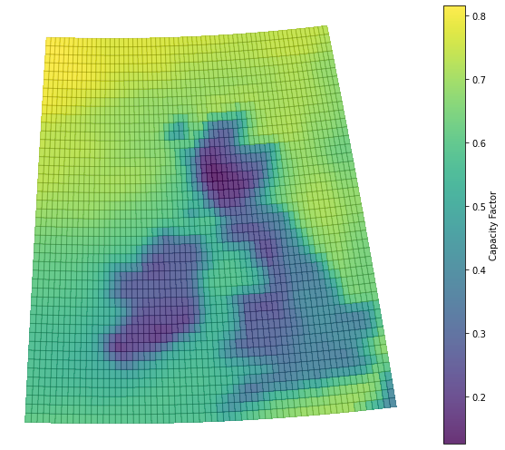
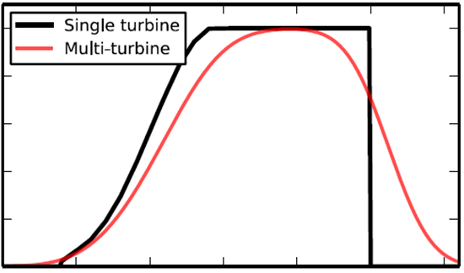
Large-scale solar and wind time series
¿Puedo hacer estas figuras para viento y sol en España?
Producing representative capacity factor time series for large regions is a scientific challenge:
1. We use historical weather data (reanalysis dataset,
spatial resolution 0.3ºx0.3º)
2. We convert the wind velocity into wind energy using power curves
3. We aggregated the time series based on installed capacity
4. We validate the methodology with historical data
Ref: Atlite documentation
1

Slide 2
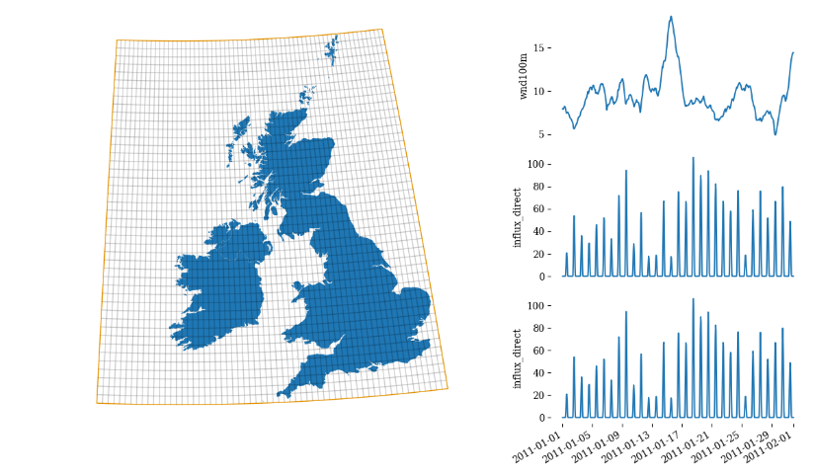
https://atlite.readthedocs.io/en/latest/examples/plotting_with_atlite.html
a) Grid cells Reanalysis data set Conversion Capacity layout Agreggation of time series (wighted by capacity)
Solar radiation ambient emperature
Figure 14.3 . Four steps involved in the production of large-region representative time series for renewable power. (a) Grid-cells in the reanalysis dataset ERA5 for Spain, (b) Conversion process from weather variables, (c) Example of capacity layout, (d) Capacity factor time series in three representative grid cells that are aggregated (weighted by capacity) to obtain a representative time series for the region.
¿Puedo hacer estas figuras para viento y sol en España?
Obtaining representative time series for renewable power generation in large regions involves four steps:
Using a simplified model, meteorological variables are transformed into renewable power generation for each grid cell. For solar PV generation, the required variables are global radiation on the horizontal ground (including its decomposition into direct and diffuse radiation if available), as well as ambient temperature. Using a simplified model, the global radiation incident on the PV panel surface is calculated (using Eq. 2.29). The cell temperature is estimated based on the ambient temperature (using Eq. 9.3), and the power generation for each hour and grid cell can then be calculated (Eq. 9.2). For wind power generation, the input variable is wind speed at hub height, which is transformed using a reference power curve. The power curve is often convoluted with a Gaussian to represent the smoothing caused by temporal and spatial integration (within the hourly resolution and within each grid cell). To model inflow time series relevant for run-of-river or reservoir hydropower, the relevant input variable is runoff, which is combined with geographically resolved information on power plant locations, basins, rivers, and tributaries.
A distribution of renewable capacity across the grid cells in a region, or capacity layout, needs to be assumed. There are several simple rules that can be used, such as distributing capacity uniformly across all grid cells, following historical layouts, or distributing capacity proportional to the renewable resource. These assumptions have a significant impact on the results, especially for wind time series, as discussed in Problem 14.10. For solar PV, heuristic rules are also used to determine the share of static vs tracking systems, monofacial vs bifacial panels, or the orientation and inclination of the systems (e.g., optimal values or a Gaussian distribution of values around the optimal).
The power time series calculated for each grid cell in (1) are then aggregated, weighted by the capacity layout assumed in (2).
Ideally, the process involves a validation step where the modeled region-wise renewable generation time series are compared with historical time series reported by Transmission System Operators (TSOs). However, a lack of historical data for the region under analysis may prevent this step. Nevertheless, a comparative analysis is always encouraged to validate the modeling approach and detect significant biases.

